Slide 1

Infrastructure as a Service and Microsoft Azure Stack Hub
Azure Stack Hub Virtual Networking
This work is licensed under a Creative Commons Attribution - ShareAlike 4.0 International Public License

Slide 2
Agenda
Network Architecture
Logical Networks
Architecture
Network Services
Virtual Networks
Gateways
Load Balancer
DNS Services
Connectivity

Slide 3
Azure Stack Hub Network Architecture

Slide 4
Azure Stack Hub logical networks
Infrastructure Network
Private Network
Storage Subnet /25
Internal VIPs Subnet /25
Azure Stack Hub Hosts
Hyper-V
NIC
Team
Hardware Lifecycle Host
Deployment VM
BMC
TOR Switch
BMC Switch
Hyper-V
NIC
Team
BMC
BMC Network
Switch Infrastructure Network

Slide 5
Switch infrastructure network
Infrastructure Network
Minimum size /26
Routable Point-to-Point IP /30 (2 host IPs)
Subnets for routing purposes
Dedicated /32 subnets for switch management interfaces
/32 subnets for loopback addresses assigned to the switch
Private Network
Storage Subnet /25
Internal VIPs Subnet /25
Azure Stack Hub Hosts
Hyper-V
NIC
Team
Hardware Lifecycle Host
Deployment VM
BMC
TOR Switch
BMC Switch
Hyper-V
NIC
Team
BMC
BMC Network
Switch Infrastructure Network
Routable? Yes! This range of IP addresses need to be routed externally of the Azure Stack Hub solution but not be fully public as with the Public VIP addresses

Slide 6
Switch management network
Infrastructure Network
Minimum size /29 (6 host IPs)
Dedicated for connecting the management ports of the switches
Allows an out-of-band access for deployment, management and troubleshooting
Calculated from the Switch Infrastructure Network mentioned before.
Private Network
Storage Subnet /25
Internal VIPs Subnet /25
Azure Stack Hub Hosts
Hyper-V
NIC
Team
Hardware Lifecycle Host
Deployment VM
BMC
TOR Switch
BMC Switch
Hyper-V
NIC
Team
BMC
BMC Network
Switch Infrastructure Network

Slide 7
BMC network
Infrastructure Network
Minimum size /27 (30 host IPs)
Dedicated network for connecting all the baseboard management controllers
Deployment automation will need to control the host computer power through the BMCs.
Hardware Lifecycle Host (HLH) will be located on this network if present
Private Network
Storage Subnet /25
Internal VIPs Subnet /25
Azure Stack Hub Hosts
Hyper-V
NIC
Team
Hardware Lifecycle Host
Deployment VM
BMC
TOR Switch
BMC Switch
Hyper-V
NIC
Team
BMC
BMC Network
Switch Infrastructure Network
Routable? Optional The BMC Network can be private or routable, according to customer security preferences.

Slide 8
Private network
/20 (4096 host IPs)
Divided into two subnets:
Storage Network /25 (126 host IPs)
Used to support the use of Spaces Direct and SMB (Server Message Block) storage traffic and virtual machine live migration.
Internal Virtual IP Network /25
Dedicated to internal-only VIPs for the Software Load Balancer
Container network: A /23 (512 IPs)
Dedicated to internal-only traffic between containers running infrastructure services.
Infrastructure Network
Private Network
Storage Subnet /25
Internal VIPs Subnet /25
Azure Stack Hub Hosts
Hyper-V
NIC
Team
Hardware Lifecycle Host
Deployment VM
BMC
TOR Switch
BMC Switch
Hyper-V
NIC
Team
BMC
BMC Network
Switch Infrastructure Network
Routable? No. This network is private to the Azure Stack Hub Region. It does not expand beyond the border switches of the Azure Stack Hub region.

Slide 9
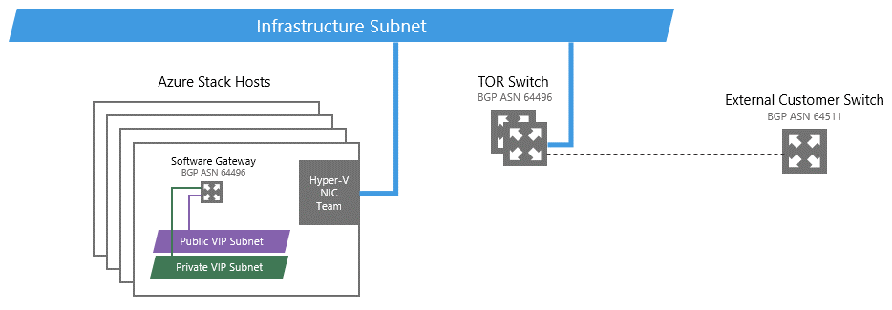
Azure Stack Hub infrastructure network
/24 network subnet
Dedicated for internal Azure Stack Hub components to communicate and exchange data among themselves
Requires routable IPs but is isolated to the solution using Access Control Lists
Is not expected to traverse beyond the border switches except for a very small range utilized by some services

Slide 10
Public infrastructure network
/27 network subnet
Very small range from the Infrastructure subnet with external-accessible or public IP addresses
Dedicated to some Azure Stack Hub components that may require access to or from external resources

Slide 11
Public VIP network
Size on this subnet can range from a minimum of /26 (64 hosts) to a maximum of /22 (1022 hosts) (Recommendation is to plan for a /24 network)
Contains the external-accessible or public IP addresses that will be assigned to a small set of Azure Stack Hub services with the remainder to be used by the tenant VMs.
The Azure Stack Hub Infrastructure will use at least 8 addresses from this Public VIP Network

Slide 12
Azure Stack Hub single-rack architecture
Routed Networks
Loopback, P2P
Switch Management
BMC Management
Infrastructure Network
Public VIP
Private Networks
Storage Network
Private VIP
Border Gateway Protocol (BGP)
Router ID (loopback)
Autonomous system number (ASN)
Unique router-id that identifies a route domain

Slide 13
Azure Stack Hub Network Architecture (Advanced)

Slide 14
The new Azure Stack Hub Rack will be integrated in the datacenter where other aggregation switches and border devices are already running production workloads and have their own subnets defined.
ANY Subnet
DC Subnet
Any Client
Machine
Any DC Infra

Slide 15
Untagged
VLAN
Once the Azure Stack Hub rack is connected, the TORs will be connected to aggregation switches or the core networking at customer datacenter. TORs will have uplinks connected to the existing Aggregation Routers. In addition, two L2 networks will be defined for the Azure Stack Hub Rack (Storage and Infrastructure Networks)
TOR Switch Router
Storage Router Interface
Agg. Router Interface
Infra Router Interface
ANY Subnet
DC Subnet
Any Client
Machine
Any DC Infra

Slide 16
Tenant xN
Tenant xN
Encap
Host:
Default Compartment
Host:
HNV PA compartment
Storage x2
Mgmt
PA x2
NC x3
AD x3
SLB MUX x2
SDN GW x2
Other Infra xN
Storage x2
PA x2
NC
AD
SLB MUX
SDN GW
Storage 2
Infrastructure
Subnet
Untagged
Storage Subnet
VLAN
Azure Stack Hub will deploy a Switch Embedded Teaming on top of the 2 physical network cards and will create 5 vNICs.
2 for the Storage Network and 1 for Mgmt on the infrastructure network
2 for the Provider Address HNV compartment where the packets will be encapsulated
Network Contoller, AD, SLB MUXs, SDN GWs and other infrastructure VMs will be connected to the Infrastructure Network
Tenants Virtual Networks will be defined on top of the HNV compartment
TOR Switch Router
Storage Router Interface
Agg. Router Interface
Infra Router Interface
ANY Subnet
DC Subnet
Any Client
Machine
Any DC Infra

Slide 17
Tenant xN
Tenant xN
Encap
Host:
Default Compartment
Host:
HNV PA compartment
In Via MUX
Out Via Host
Storage x2
Mgmt
PA x2
NC x3
AD x3
SLB MUX x2
SDN GW x2
Other Infra xN
Private VIP
Storage x2
PA x2
NC
AD
SLB MUX
SDN GW
Storage 2
Infrastructure
Subnet
Private VIP
Subnet
Untagged
Storage Subnet
VLAN
For internal load balancing purposes, Azure Stack Hub defines a Private VIP Pool
This Pool will be used by the Software Load Balancer Manager and also to provide load balancing between subnets in the same Virtual Network
TOR Switch Router
Storage Router Interface
Agg. Router Interface
Infra Router Interface
ANY Subnet
DC Subnet
Any Client
Machine
Any DC Infra

Slide 18
Tenant xN
Tenant xN
Encap
Host:
Default Compartment
Host:
HNV PA compartment
In Via MUX
Out Via Host
Storage x2
Mgmt
PA x2
NC x3
AD x3
SLB MUX x2
SDN GW x2
Other Infra xN
Private VIP
Public
VIP
Storage x2
PA x2
NC
AD
SLB MUX
SDN GW
Storage 2
Infrastructure
Subnet
Public VIP
Subnet
Private VIP
Subnet
Untagged
Storage Subnet
VLAN
For Public load balancing purposes, Azure Stack Hub defines a Public VIP Pool
This Pool contains the external-accessible or public IP addresses that will be assigned to a small set of Azure Stack Hub services with the remainder to be used by the tenant VMs.
TOR Switch Router
Storage Router Interface
Agg. Router Interface
Infra Router Interface
ANY Subnet
DC Subnet
Any Client
Machine
Any DC Infra

Slide 19
Azure Stack Hub Network Services

Slide 20
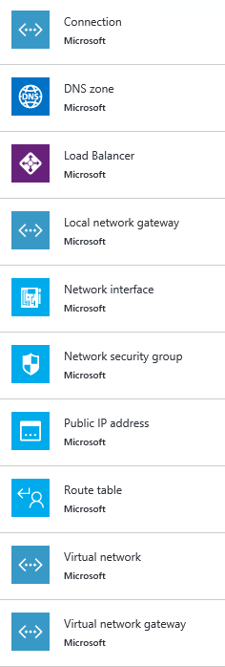



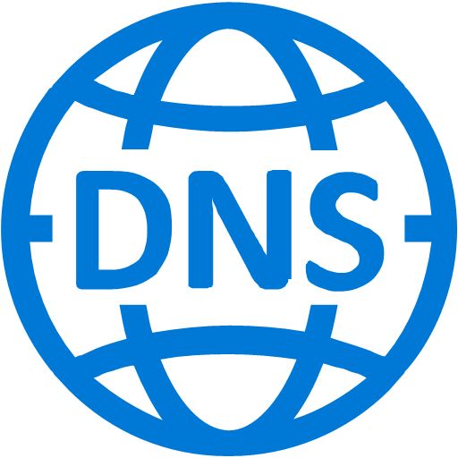




Network services in Azure Stack Hub
Infrastructure-as-a-Service (IaaS) Network Resources
Application Gateway
Virtual Network
Load Balancer
Subnet
Public IP Address
Network Security Group (NSG)
DNS Zone
Network Security Rule
Network Interface (NIC)
Virtual Network Gateway
User Defined Route (UDR)
Local Network Gateway
Connection

Slide 21
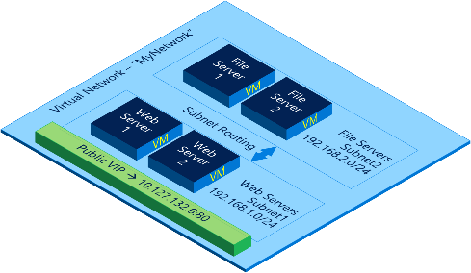
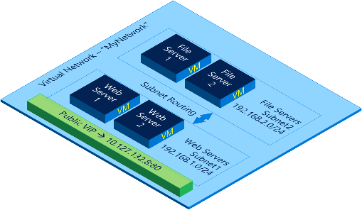
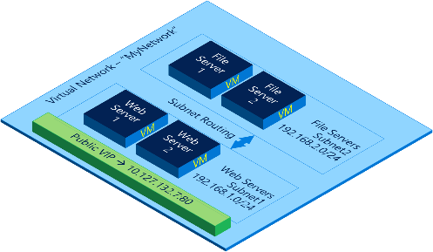
Production
Development
Testing
Virtual network
Internet
Virtual Network
Subnet
VNets are completely isolated from one another, allowing you to create disjointed networks for development, testing and production that all use the same CIDR address blocks.
Create subnets with your private or public IP address spaces.
Internet access by default through NAT. No Gateway needed.

Slide 22
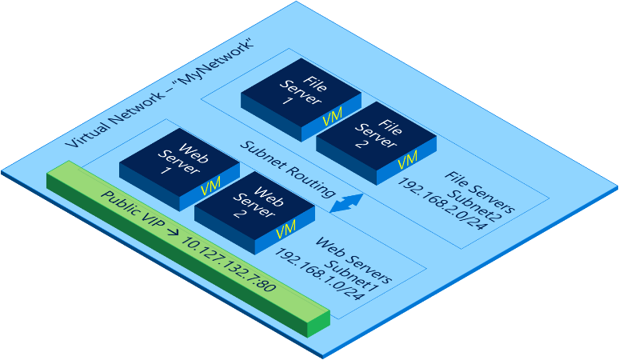
Production
Development
Virtual network
Internet
Virtual Network
Subnet
VNets are completely isolated from one another, allowing you to create disjointed networks for development, testing and production that all use the same CIDR address blocks.
Create subnets with your private or public IP address spaces.
Internet access by default through NAT. No Gateway needed.
Testing

Slide 23

Production
Virtual network
Internet
Virtual Network
Subnet
VNets are completely isolated from one another, allowing you to create disjointed networks for development, testing and production that all use the same CIDR address blocks.
Create subnets with your private or public IP address spaces.
Internet access by default through NAT. No Gateway needed.
Development
Testing

Slide 24

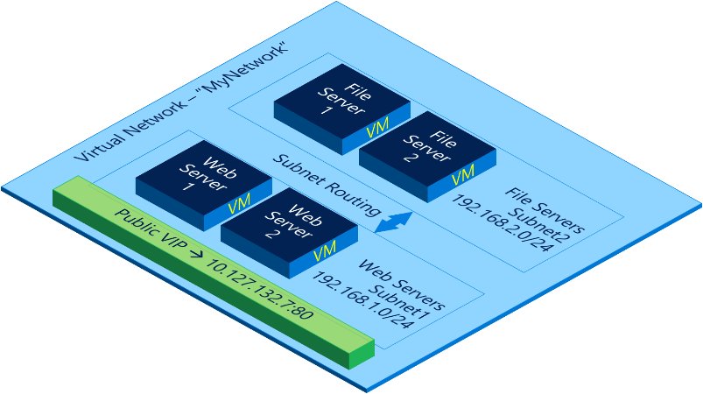
Virtual network
Internet
Virtual Network
Subnet
VNets are completely isolated from one another, allowing you to create disjointed networks for development, testing and production that all use the same CIDR address blocks.
Create subnets with your private or public IP address spaces.
Internet access by default through NAT. No Gateway needed.
Production
Development
Testing

Slide 25

Network security groups
On Premises 10.0/16
Segment network
5 tuple ACLs on both directions
Protect Internet and internal traffic
Enables DMZ subnets
Associated to subnets and NICs
ACLs updated independent of VMs
Internet
√
√
VPNs
√
√
VPN GW
Backend
10.3/16
Mid-tier
10.2/16
Frontend
10.1/16
Virtual Network

Slide 26
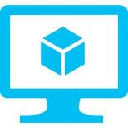


User-defined routes
Internet
Control traffic flow with custom routes
Attach route tables to subnets
Specify next hop for any address prefix
Set default route to force tunnel all traffic to on-premises or virtual appliance
Virtual Network
VM with “IP Forwarding”
System
Route
Front-end subnet
Back-end subnet
System route
Default Route
VM/Appliance
User-defined route

Slide 27

Software load balancer
Balances load among one or more VM instances
Layer 4 Load Balancer
Allows port redirection
Control traffic to endpoints with inbound NAT rules
Provides high availability for workloads with failover
Internet
Internet
151.2.3.4 (VIP)
LB
131.3.3.3
(Instance-level IP)
131.3.4.4
(Instance-level IP)
VM1
VM2
IP1
IP2

Slide 28

Public IP addresses
Public IP Addresses can be optionally assigned to Load Balancer and Virtual Machines
Only IPv4 is supported
Used for incoming and outgoing connections

Slide 29
DHCP in Azure Stack Hub
Azure (Stack) provided/managed service
All addresses are DHCP-based
Address not allocated until object created
Addresses are recovered when object is deallocated
Static addresses are DHCP reservations
Address prefix comes from VNet/subnet definitions
Beware! Using Group Policy to configure DHCP can result in isolated VM without any IP address.

Slide 30
DNS Services in Azure Stack Hub

Slide 31

DNS services in Azure Stack Hub
DNS Host Name Resolution
Support for DNS Name Label
Assign a hostname to a Public IP Address resource
An ‘A’ Record is created in Azure Stack Hub DNS against a fixed DNS suffix
iDNS
Name resolution for hostnames within VMs in the same the VNet
DNS Zone and Record Set creation
Tenants can create a DNS Zone in Azure Stack Hub and create DNS Records in that zone
Zone and Records are resources that belong to the tenant subscription that created them
The resources can only be modified or deleted by that subscription
However, unlike Azure, any tenant can resolve queries for these records.
Unlike Azure DNS, Azure Stack Hub DNS is NOT multi-tenant.

Slide 32
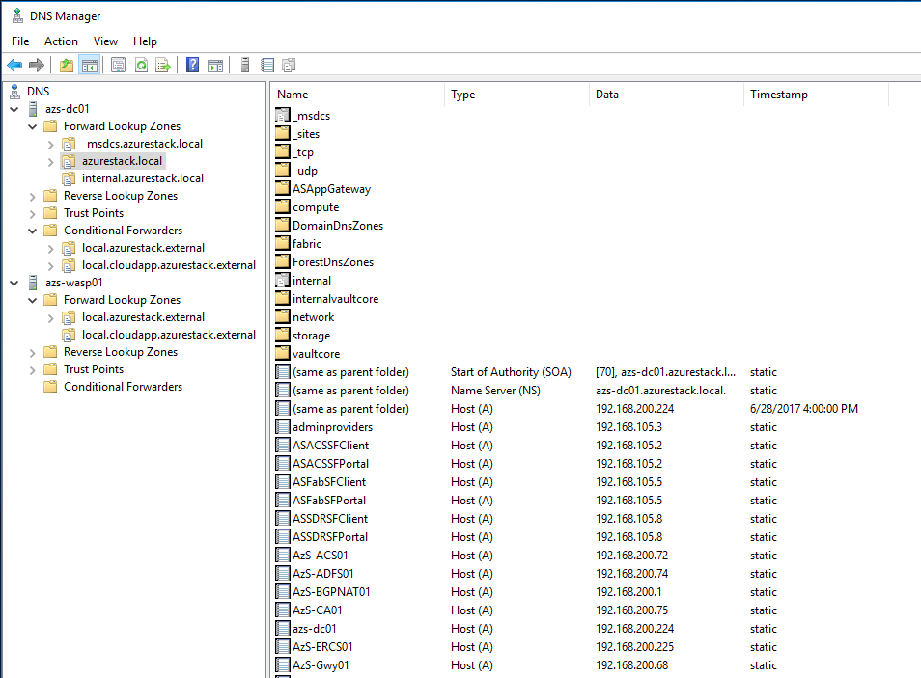
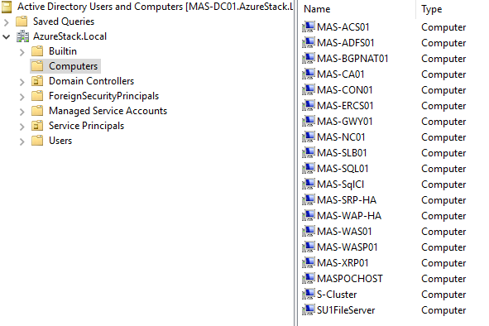
AzureStack.local DNS zone
The AzureStack.local DNS Zone provide name resolution for the Infrastructure Virtual Machines like the Network Controller, the Domain Controllers, the load balancers or the Gateways.
It is also the Internal Domain name used by Azure Stack Hub Infrastructure components

Slide 33
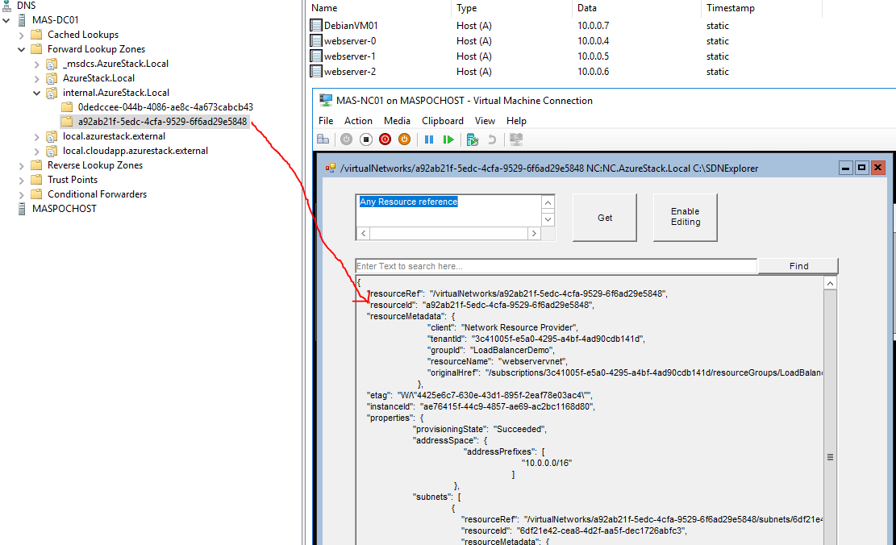
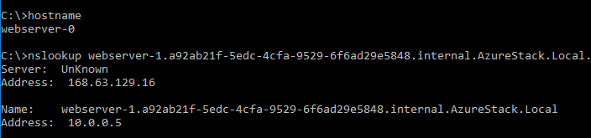
Internal.AzureStack.local DNS zone (iDNS)
The Internal.AzureStack.local DNS Zone provides the following capabilities:
Shared DNS name resolution services for tenant workloads (iDNS)
Authoritative DNS service for name resolution and DNS registration within the tenant virtual network.
Recursive DNS service for resolution of Internet names from tenant VMs. Tenants no longer need to specify custom DNS entries to resolve Internet names (for example, www.bing.com).
Each Virtual Network has its own GUID DNS subzone folder. The GUID represents the VNET Resource ID created in Network Controller by Azure Stack Hub

Slide 34
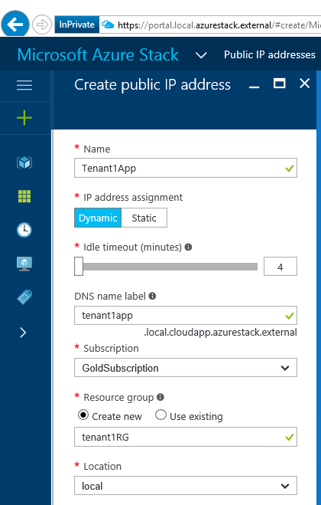
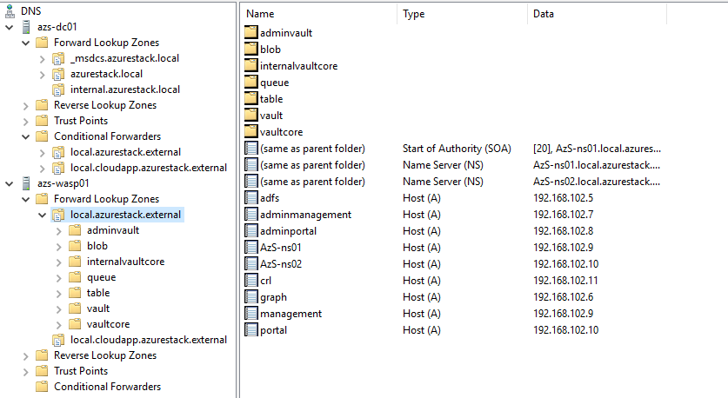
local.AzureStack.External DNS zone (iDNS)
Region Name
Maps to your Resource Location
Part of DNS namespace for external service endpoints
*.[REGION].[EXTERNALDOMAINNAME]
External Domain Information
DNS zone for all tenant records and external service endpoints
Zone that customers will need to integrate their DNS infrastructure with
*.[REGION].[EXTERNALDOMAINNAME]

Slide 35
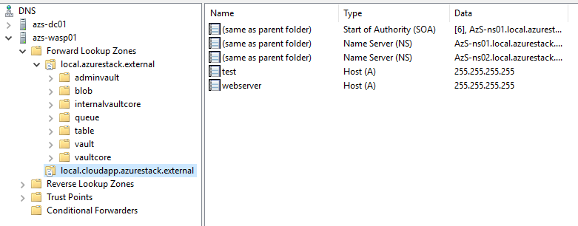
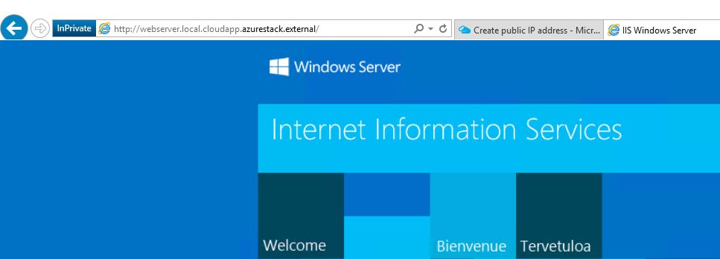
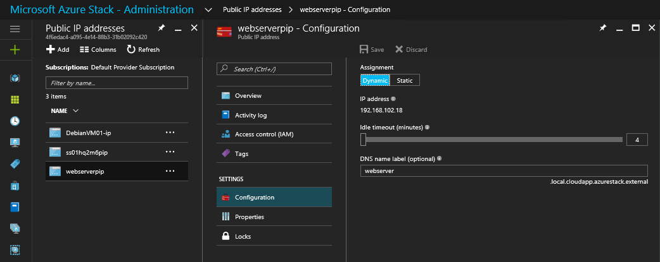
local.cloudapp.AzureStack.External DNS zone (iDNS)
The local.cloudapp.azurestack.external DNS zone is used to expose Tenant applications or services to internet or other external networks using Public IP addresses defined in Azure Stack Hub

Slide 36
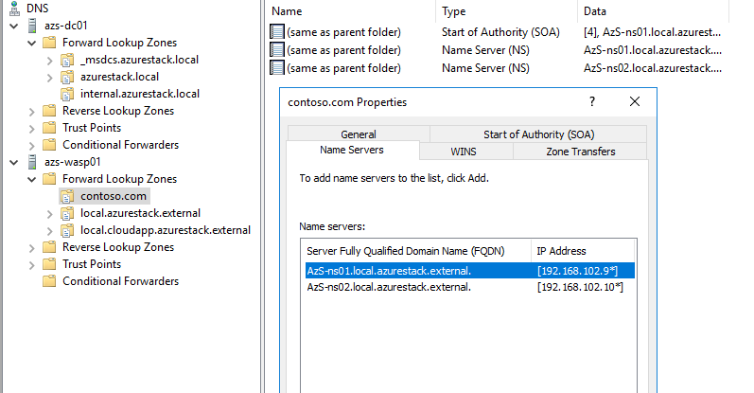
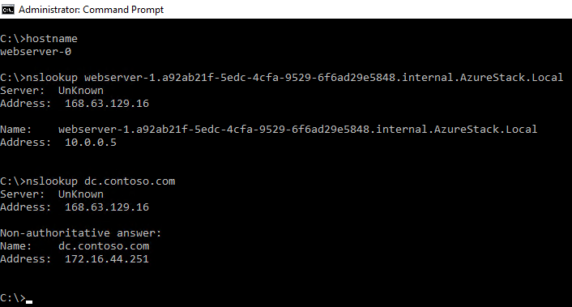
DNS forwarders in Azure Stack Hub
DNS Forwarders in Azure Stack Hub DNS servers allows infrastructure servers and Tenant virtual machines to resolve names from zones within your datacenter
Azure Stack Hub DNS server configuration
Tenant VM resolving VNET and external to Azure Stack Hub datacenter names using iDNS and conditional forwarders

Slide 37
DNS services in Azure Stack Hub
Corp.local
External DNS
DNS Servers: 168.63.129.16
Queries for non-authoritative zones
Delegations for MAS zones
Tenant VM
Conditional Forwarding
sea.azurestack.external → Azure Stack Hub DC
sea.azurestack.external
iDNS proxy
SoA for zone
Azure Stack Hub DNS
Authoritative
Resolver
Tenant created Zone:
Contoso.com
DNS Server 1
DNS Server 2
*.azurestack.local
SoA for internal zone
Azure Stack Hub DC
Recursive
Resolver
DNS Servers: 168.63.129.16
Infra Role
Azure Stack Hub

Slide 38
Connectivity in Azure Stack Hub

Slide 39


Gateways in Azure Stack Hub
Azure Resource Manager (ARM)
NRP
Network Resource Provider
Leverages Multi-Tenant Gateway in Windows Server 2016
High Availability through M+N model (Active/Passive)
Gateway Manager balances load across Gateway instances
Monitors Health and handles failover in the event any active instance fails.
REST
Network Controller
NORTHBOUND API
GWM
Gateway Manager
ToR
WMI
Virtual Network
BGP
Subnet-1
Host
Host
Gateway Pool
GW
VM
GW
VM
GW
VM
VSwitch
VSwitch
VFP
VFP

Slide 40

Gateways in Azure Stack Hub
Azure Resource Manager (ARM)
NRP
Network Resource Provider
Leverages Multi-Tenant Gateway in Windows Server 2016
High Availability through M+N model (Active/Passive)
Gateway Manager balances load across Gateway instances
Monitors Health and handles failover in the event any active instance fails.
REST
Network Controller
NORTHBOUND API
GWM
Gateway Manager
ToR
WMI
Virtual Network
BGP
Subnet-1
Gateway Subnet
Host
Host
Gateway Pool
GW
VM
GW
VM
GW
VM
VSwitch
VSwitch
VFP
VFP

Slide 41


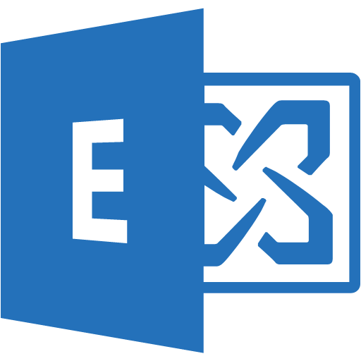
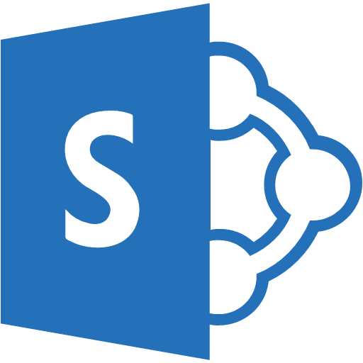


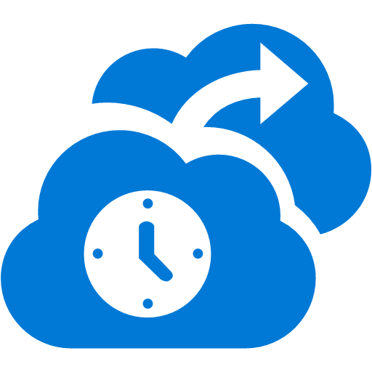



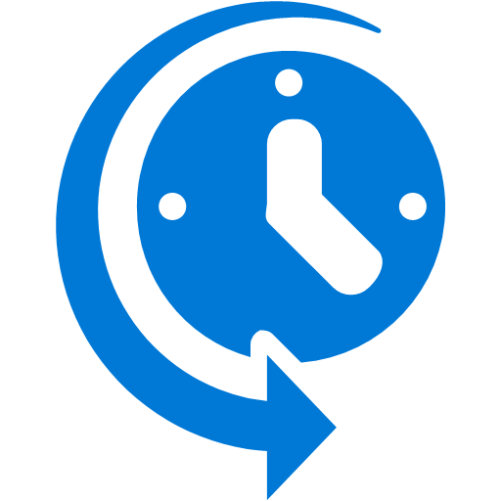
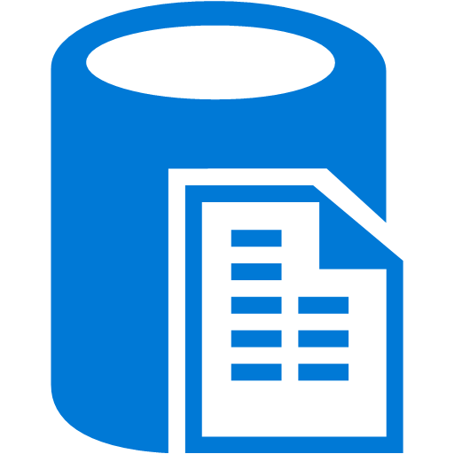
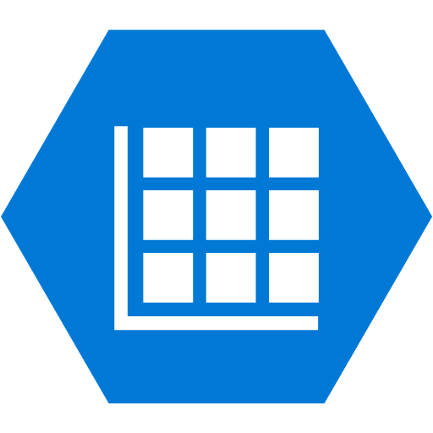
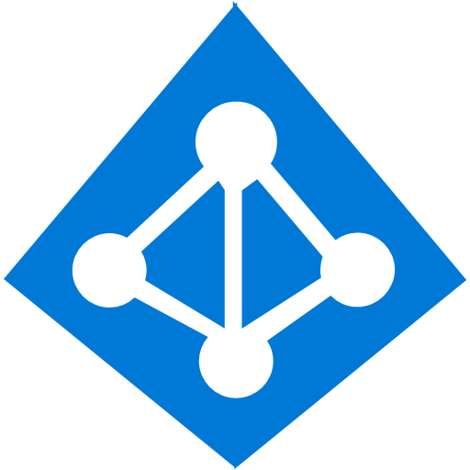
Connecting Azure Stack Hub to Azure via Express Route
Azure
Consumers
Access over public IP
DNS resolution
Connect from anywhere
Azure
1
Internet
Virtual Network
2
Developers
POC Efforts
Small scale deployments
Connect from anywhere
P2S SSTP tunnels
Azure Stack Hub
3
Virtual Network
SMB, Enterprises
Connect to Azure compute
Backend
Mid-tier
Frontend
Backend
Mid-tier
Frontend
IPsec S2S VPN tunnels
SMB & Enterprises
Mission critical workloads
Backup/DR, media, HPC
Connect to Microsoft services
Azure Stack Hub
4
Virtual Network
4
SMB & Enterprises
Mission critical workloads
Backup/DR, media, HPC
Connect to Microsoft services
Backend
Mid-tier
Frontend
Private LAN/WAN
ExpressRoute

Slide 42





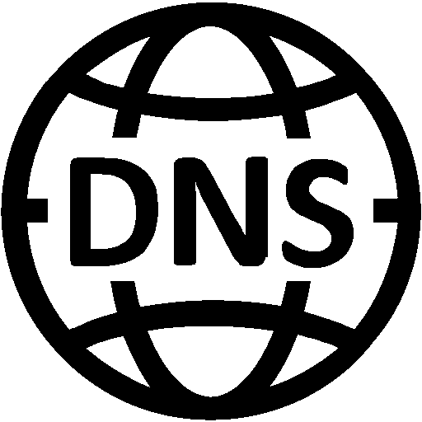
Connecting from Azure Stack Hub
Available Options
VNET Peering
Site-to-Site (S2S) VPN
Outbound NAT
Not available (today)
Point-to-Site VPN*
vNet-to-vNet VPN*
Internet
Virtual Network
Cross premises Connectivity
*) possible using RRAS or 3rd-party solutions

Slide 43
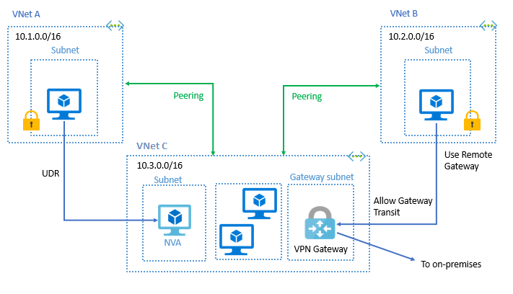
VNET Peering
Connectivity between VNETs without NVAs
Only within an Azure Stack Hub System. Not between two systems
Latency between VMs in peered VNETs is the same as the latency within a VNET
Traffic is routed within the infrastructure – Not exposed to the internet.
Hub- Spoke Architecture and use Gateway/NVA in a peered VNET for On-prem routing.
Available in update 2008 and beyond.
Hub Spoke Architecture

Slide 44
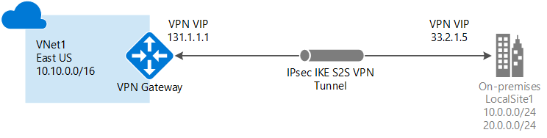
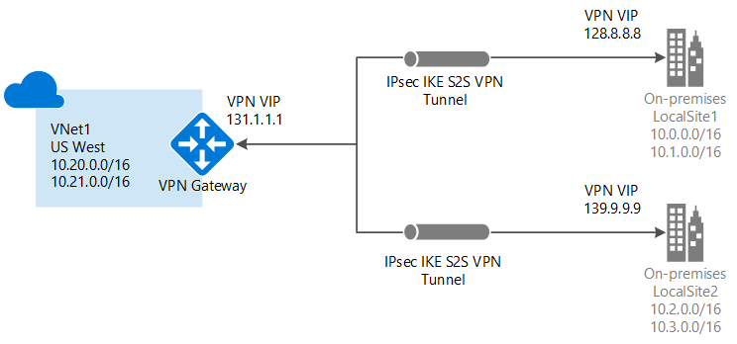
Connecting from Azure Stack Hub
Site-to-Site (S2S) VPN
Requires a VPN device or RRAS
Communication is encrypted and secure
IPsec (IKEv1 and IKEv2)
Custom IPSec/IKE policy configurations
Bandwidth limited by the maximum throughput of the tunnel
No support for Policy-based gateways
Site-to-Site Scenario
Multi-Site Scenario

Slide 45
Connecting from Azure Stack Hub
Outbound NAT
Enabled by default
Each virtual network gets a public IP address assigned to it
Outbound access via NAT using the Public IP (VIP) of the virtual machine
Works only for communication initiated by the VM and destined for external sites
Internet
Virtual Network
using its own Public IP
vNet NAT IP
Subnet
VM w/PublicIP
VM(s) without PublicIP

Slide 46
Hybrid connectivity options
Single-tenant Azure Stack Hub
An Azure Stack Hub deployment that looks, at least from a networking perspective, as if it’s one tenant.
There can be many tenant subscriptions but all traffic travels over the same networks.
Doesn’t need to be isolated via an encrypted tunnel.
Multi-tenant Azure Stack Hub
Each tenant subscription’s traffic that's bound for networks that are external to Azure Stack Hub must be isolated from other tenants’ network traffic.

Slide 47
Hybrid connectivity options
Intranet deployment
Sits on a corporate intranet
Typically on private IP address space and behind one or more firewalls
The “public” IP addresses are not truly public, as they can’t be routed directly over the public internet.
Internet deployment
Connected to the public internet
Uses internet-routable public IP addresses for the public VIP range
May sit behind a firewall, but the public VIP range is directly reachable from the public internet and Azure

Slide 48
Hybrid connectivity options
Scenario | Method | Factors | Target
Single tenant, intranet deployment | Outbound NAT | Better bandwidth No gateways required No isolation/encryption beyond TOR | Enterprise of trusted tenants Express Route
Multi-tenant Azure Stack Hub, intranet deployment | Site-to-Site VPN | VPN limited bandwidth Requires gateway VPN device at each target | Enterprise with secured traffic
Single tenant, internet deployment | Outbound NAT | Unencrypted traffic No isolation beyond TOR | Hosting Dedicated network & Stack
Multi-tenant, internet deployment | Site-to-Site VPN | VPN limited bandwidth Requires gateway VPN device at each target | Hosting Multi-tenant cloud Untrusted

Slide 49

Connectivity Options in Azure Stack Hub
Note: Tenants also get outbound connectivity to the Internet or Corporate Network via SLB and Outbound NAT. No NAT Gateway is required!
Azure
Azure Stack Hub
Site-to-Site VPN
IPSec Connection between Azure Stack Hub and Azure or between Azure Stack Hub and remote VPN device
Point-to-Site
Client VPN Connection over SSTP into Azure Stack Hub tenant Virtual Network
Post-GA
Vnet-to-Vnet
VPN connection between two Virtual Networks
Post-GA
Multi-Site
Connect multiple sites to a single Virtual Network
Express Route
Connect Azure Stack Hub to your Express Route circuit via
To Azure Only

Slide 50
Questions?

Slide 52
Appendix

Slide 53
Azure Stack Hub SDN Troubleshooting

Slide 54
Service Admin Tools

Slide 55
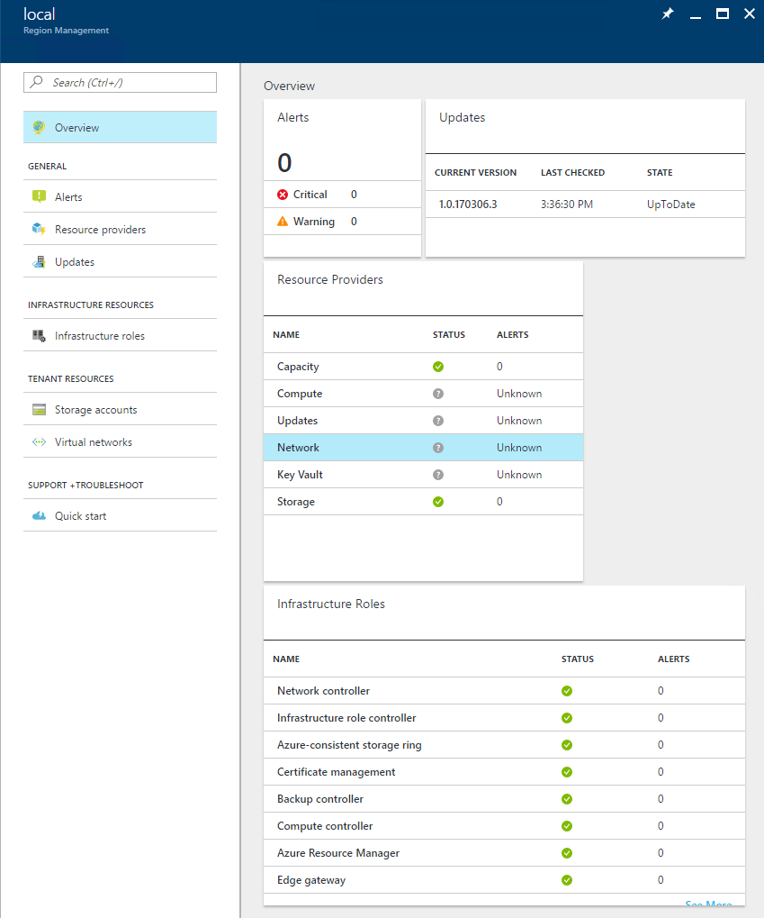
What tools are available to the Service Admin?
System Health & Monitoring Alerts
Network Service Provider
Infrastructure Roles
Network Controller
Load Balancing Multiplexer (MUX)
Edge Gateway
Resource Availability
Virtual Networks
Load Balancers
Public IP Pools
0

Slide 56
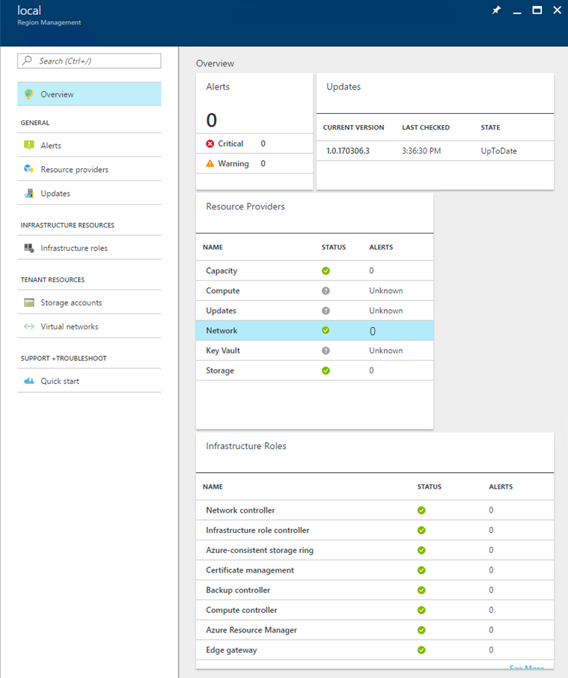
Network Health Monitoring Alerts
System Health Alerts show up on the Region Management blade
Contain remediation instructions that are intended to allow the Service Admin to fix the problem themselves, via the Admin Portal.
We will be investing in this area up to and after release.
…For any issue that is not reported via alerts, we need to collect logs.

Slide 57
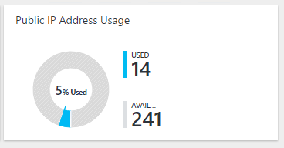

Public IP Address Pool Management
Network Resource Provider Blade shows Public IP Address Usage.
If utilization of the Public IP Address Pool reaches 75%, the Service Admin will get an alert.
The Service Admin can add more public IP Addresses via the Capacity management blade.
Beware of these pitfalls!
Public IP Address blocks must be no smaller than /26 and no larger than /22
If customer chose to do static routes for your ToR to Agg Switches at deployment time instead of BGP peering, they will have to add static routes on the Agg switches for each new Public IP Address block they add to Azure Stack Hub!

Slide 58
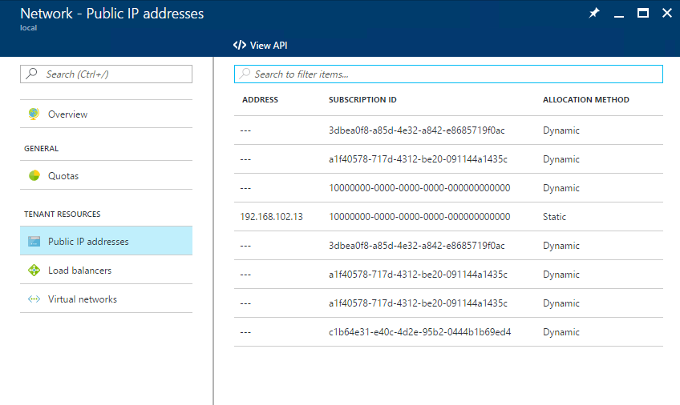
Public IP Address Allocation
Admin sees VIPs are used before tenant VMs are deployed
Admin sees list of Public IP addresses, but the number doesn’t account for all the Public IP addresses in the Usage summary tile
Public IP Addresses lists “Tenant Resources” but some of these were created for the infrastructure services.
Some resources were allocated by the Network Controller before the NRP was deployed
Case | Exists in NRP | Exists in Network Controller
Static Allocation – Not bound to an interface | Yes | Yes
Static Allocation – Bound to an interface | Yes | Yes
Dynamic allocation – Not bound to an interface | Yes | No
Dynamic allocation – Bound to an interface | Yes | Yes
Allocated during deployment before NRP is deployed | No | Yes
Allocated during deployment after NRP is deployed | Yes | Yes

Slide 59


Public IP Pool Capacity Alerts
Since Public IP address blocks can take time to obtain, there are alerts at the 70%, 90% and 100% thresholds.
Alert Message | Severity | Description | Remediation Steps
Public IP address utilization at 70% across all pools. | Warning | Public IP address utilization is at 70% across all pools. If utilization reaches 100%, users will be unable to create VM instances, or create public IP addresses. | You will need to add another block of Public IP Addresses in order to continue to service requests from tenants. 1. Acquire another block of IP Addresses from your Network Service Provider. 2. Log in to the Azure Stack Hub Portal using your Service Manager account. 3. Open the capacity Management Blade and click on the Public IP Pools tile. 4. Click the Scale-Out Action button and provide the details of your new Public IP Address Pool.
Public IP address utilization at 90% across all pools. | Warning | Public IP address utilization is at 90% across all pools. If utilization reaches 100%, users will be unable to create VM instances, or create public IP addresses.
Public IP address utilization at 100% across all pools. | Critical | Public IP address utilization is at 100% across all pools. Users are unable to create VM instances, or create public IP addresses.
The Capacity Management RP blade is NOT present in TP3, so customers will NOT be able to follow the remediation steps to add IP Pools. This will be available by GA.

Slide 60
Troubleshooting Common Issues

Slide 61
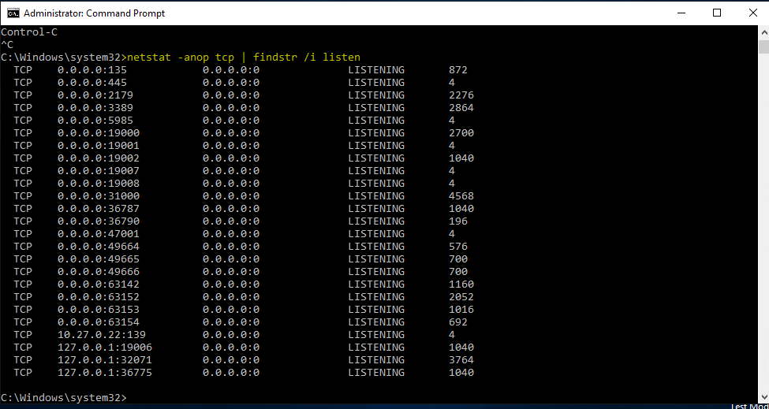
Troubleshooting SLB Issues - VIP Connectivity
I can’t ping a VIP for my VM or service!
VIPs are managed by SLB which supports only TCP or UDP, not ICMP so ping will fail even if all is working properly!
Check that the VM that is hosting your service is up and running!
Find a port that your VM instance is listening on.
From the DVM or console VM try Test-NetConnection and provide the port you want to probe.
Check the local firewall in the VM
Check the Network Security Group to ensure that port is allowed
Check if there are inbound NAT Rules for that Port.

Slide 62
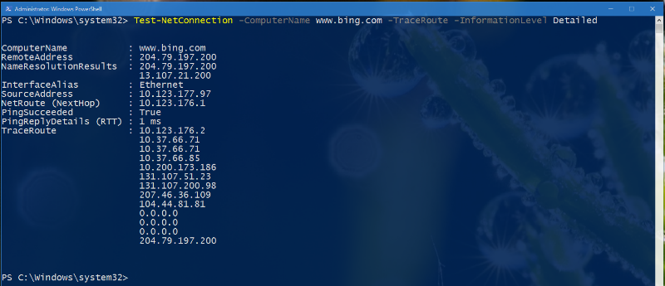
Troubleshooting SLB Issues – Outbound Connectivity
I can’t reach the Internet from my VM!
VM instances connect through SLB and Outbound NAT by default.
Is the tenant unable to reach the endpoint by DNS name but able to reach the IP address?
Try running Tracert from an administrative command prompt on the VM instance experiencing problems to the external endpoint.
If the packet gets past the Top of Rack switch (ToR), the issue is most likely with the customer network, not Azure Stack Hub.

Slide 63
Troubleshooting DNS Issues
I can’t reach Bing.com from my VM!
*
All DNS Queries on Azure Stack Hub go through MAS DNS.
Is the tenant unable to reach the endpoint by DNS name but able to reach the IP address?
Unless Tenant VMs have specified Custom DNS Settings explicitly, they should see that their DNS Server is 168.63.129.16
Run Test-NetConnection – ComputerName 168.63.129.16 –Port 53 to test connectivity to MAS-DNS
If the Endpoint is an Azure Stack Hub endpoint, MAS-DNS should resolve it. If it is an external endpoint, there may be an issue with the DNS forwarding server.
Get-DnsServerForwarder – Computer 168.63.129.16
* Unless Tenants have specified Custom DNS Settings in their deployment.

Slide 64
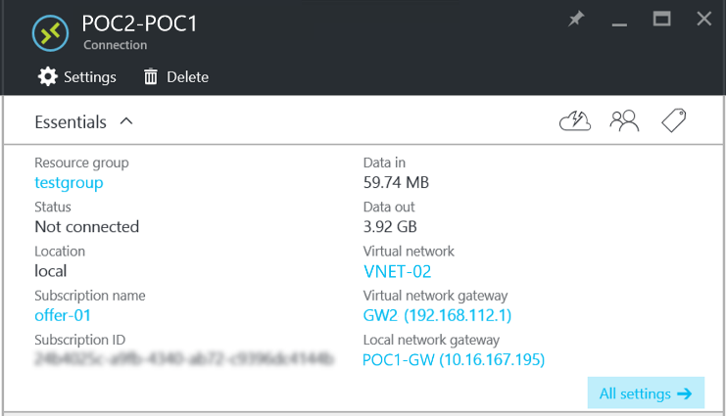
Troubleshooting Edge Gateway Issues
I can’t connect my VPN Device to my Azure Stack Hub Virtual Network Gateway!
You will not get a Public IP Address (VIP) assigned to your gateway until the Connection resource is created.
May show status as disconnected until you put traffic through it.

Slide 65
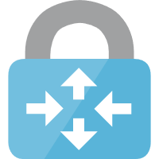
Troubleshooting Edge Gateway Issues
I can’t connect my VPN Device to my Azure Stack Hub Virtual Network Gateway!
Some settings that might help when you’re configuring the VPN device to connect to Azure Stack Hub.
Device compatibility is the same as Azure’s
https://docs.microsoft.com/en-us/azure/vpn-gateway/vpn-gateway-about-vpn-devices
IPSec VPN Gateway Settings
QuickMode settings
PerfectForwardSecrecy = PFS2048
AuthenticationTranformationConstant = SHA256128
CipherTransformationConstant = DES3
SALifeTimeSeconds = 1233
IdleDisconnectSeconds = 500
SALifeTimeKiloBytes = 2000
MainMode policy default settings
DiffieHellmanGroup = Group2
IntegrityAlgorithm = SHA256
EncryptionAlgorithm = AES256
SALifeTimeSeconds = 1234
SALiftimeKiloBytes = 2000

Slide 66
Deep Troubleshooting – Using tools for specific SDN issues
The SDN troubleshoooting tools typically require that you:
Have administrative access to login to the Role (e.g. NC)
Can run PowerShell Cmdlet from the desktop (again, as admin)
In general involve “breaking the Glass”

Slide 67
Get-AzureStackLog

Slide 68
When All Else Fails…
Run in an elevated Command Prompt on the DVM or Host.
Without Date/Time boundaries it will default to 4 hours, so make sure you get the right timeframe.
There are currently 49 roles that you can filter by! Key roles for Networking are:
NRP – Network Resource Provider
NC – Network Controller
SLB – Software Load Balancer
Gateway – Edge Gateway (S2S VPN Gateway)
You should collect ALL of these if you are experiencing Networking Issues!
Get-AzureStackLog -OutputPath C:\AzureStackLogs -FilterByRole NRP,NC,SLB,Gateway

Slide 69
Azure Stack Hub Logical Networks
Infrastructure Network
BMC NETWORK
This network is dedicated for connecting all the baseboard management controllers (also known as service processors, for example, iDRAC, iLO, iBMC, etc.). The Azure Stack Hub deployment automation will need to control the host computer power through the BMCs. If present, the Hardware Lifecycle Host will be located on this network as well for deployment and hardware monitoring via the BMCs. The minimum size of this network is /27 (30 host IP’s) and it can be private or routable, according to customer security preferences.
Private Network
This /24 (254 host IP’s) network is private to the Azure Stack Hub Region (does not expand beyond the border switch devices of the Azure Stack Hub region) and it is divided into two subnets, the first /25 (126 host IP’s) network is the Storage Network, it is used to support the use of Spaces Direct and SMB (Server Message Block) storage traffic and virtual machine live migration. The other /25 half is the Internal Virtual IP Network and it is dedicated to internal-only VIPs for the Software Load Balancer.
Switch Management Network
This /29 (6 host IP’s) network is dedicated for connecting the management ports of the switches, it allows an out-of-band access for deployment, management and troubleshooting, it is calculated from the Switch Infrastructure Network mentioned above.
Private Network
Storage Subnet /25
Internal VIPs Subnet /25
Azure Stack Hub Hosts
Hyper-V
NIC
Team
Hardware Lifecycle Host
Deployment VM
BMC
TOR Switch
BMC Switch
Hyper-V
NIC
Team
BMC
BMC Network
Switch Infrastructure Network
Switch Infrastructure Network
This /26 network is the subnet that contains the routable Point-to-Point IP /30 (2 host IP’s) subnets for routing purposes, dedicated /32 subnets for switch management interfaces and /32 subnets for loopback addresses assigned to the switch. This range of IP addresses need to be routed externally of the Azure Stack Hub solution but not be fully public as with the Public VIP addresses.

Slide 70
Software Defined Networking Overview

Slide 71
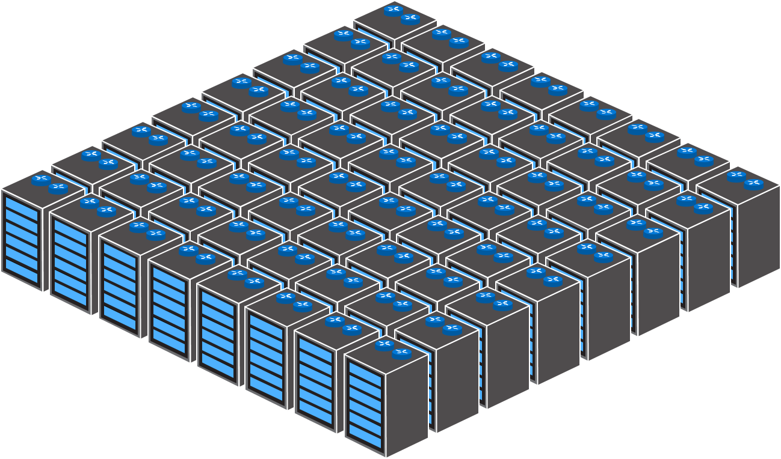
App 1
VM
App 2
VM
App 3
VM
Virtualization

Slide 72
Software Defined Network
App 1
VM
App 2
VM
App 3
VM
Virtualization

Slide 73
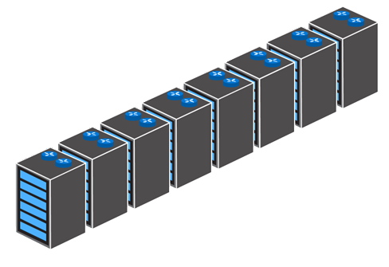
Software Defined Network
App 1
VM
App 2
VM
App 3
VM
Virtualization

Slide 74
Software Defined Network
App 1
VM
App 2
VM
App 3
VM
Virtualization

Slide 75
Software Defined Network
App 1
VM
App 2
VM
App 3
VM
Virtualization

Slide 76
Back end
Front end
File Server 1
VM
File Server 2
Web Server 1
VM
VM
Web Server 2
VM

Slide 77
Virtual Network – “MyNetwork”
File Servers
Subnet2
192.168.2.0/24
Web Servers
Subnet1
192.168.1.0/24
File Server 1
VM
File Server 2
Web Server 1
VM
VM
Web Server 2
VM

Slide 78
Virtual Network – “MyNetwork”
File Servers
Subnet2
192.168.2.0/24
Web Servers
Subnet1
192.168.1.0/24
File Server 1
VM
File Server 2
Web Server 1
VM
VM
Web Server 2
VM

Slide 79
Virtual Network – “MyNetwork”
File Servers
Subnet2
192.168.2.0/24
Web Servers
Subnet1
192.168.1.0/24
File Server 1
Subnet Routing
VM
File Server 2
Web Server 1
VM
VM
Web Server 2
VM

Slide 80
Windows Server 2016 Load Balancer

Slide 81
Virtual Network – “MyNetwork”
File Servers
Subnet2
192.168.2.0/24
Web Servers
Subnet1
192.168.1.0/24
File Server 1
Public VIP → 10.127.132.6:80
Subnet Routing
VM
File Server 2
Web Server 1
VM
VM
Web Server 2
VM

Slide 82
Virtual Network – “MyNetwork”
File Servers
Subnet2
192.168.2.0/24
Web Servers
Subnet1
192.168.1.0/24
File Server 1
Public VIP → 10.127.132.6:80
Subnet Routing
VM
File Server 2
Web Server 1
VM
VM
Web Server 2
VM

Slide 83
Virtual Network – “MyNetwork”
File Servers
Subnet2
192.168.2.0/24
File Server 1
Public VIP → 10.127.132.6:80
Subnet Routing
VM
File Server 2
Web Server 1
VM
VM
Web Server 2
VM
Web Server 3
VM

Slide 84
Virtual Network – “MyNetwork”
File Servers
Subnet2
192.168.2.0/24
Web Servers
Subnet1
192.168.1.0/24
File Server 1
Public VIP → 10.127.132.6:80
Subnet Routing
VM
File Server 2
Web Server 1
VM
VM
Web Server 2
VM

Slide 85
Virtual Network – “MyNetwork”
File Servers
Subnet2
192.168.2.0/24
Web Servers
Subnet1
192.168.1.0/24
File Server 1
Public VIP → 10.127.132.6:80
Subnet Routing
VM
File Server 2
Web Server 1
VM
VM
Web Server 2
VM

Slide 86
Virtual Network – “MyNetwork”
Database Servers
Subnet2
192.168.2.0/24
Internal VIP → 192.168.2.100:1433
Web Servers
Subnet1
192.168.1.0/24
Database Server
1
Public VIP → 10.127.132.6:80
Subnet Routing
VM
Database
Server
2
Web Server 1
VM
VM
Web Server 2
VM

Slide 87
Windows Server 2016 Multi-Tenant Gateway

Slide 88
Virtual Network – “MyNetwork”
File Servers
Subnet2
192.168.2.0/24
Web Servers
Subnet1
192.168.1.0/24
Public VIP → 10.127.132.6:80
File Server 1
Subnet Routing
VM
File Server 2
Web Server 1
VM
VM
Web Server 2
VM

Slide 89
Virtual Network – “MyNetwork”
File Servers
Subnet2
192.168.2.0/24
Multitenant
Web Servers
Subnet1
192.168.1.0/24
Public VIP → 10.127.132.6:80
File Server 1
Subnet Routing
VM
File Server 2
Web Server 1
VM
VM
Web Server 2
VM
Multitenant Gateway

Slide 90


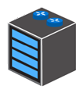
Virtual Network – “MyNetwork”
File Servers
Subnet2
192.168.2.0/24
Multitenant
VLAN Routing
Web Servers
Subnet1
192.168.1.0/24
Public VIP → 10.127.132.6:80
File Server 1
Subnet Routing
VM
File Server 2
Web Server 1
VM
VM
Web Server 2
VM
Multitenant Gateway

Slide 91

Virtual Network – “MyNetwork”
File Servers
Subnet2
192.168.2.0/24
Multitenant
VLAN Routing
Site-to-Site Tunneling
Web Servers
Subnet1
192.168.1.0/24
Public VIP → 10.127.132.6:80
File Server 1
Subnet Routing
VM
File Server 2
Web Server 1
VM
VM
Web Server 2
VM
Multitenant Gateway
Site-to-Site

Slide 92
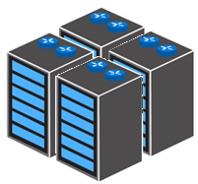
Virtual Network – “MyNetwork”
File Servers
Subnet2
192.168.2.0/24
Multitenant
VLAN Routing
Site-to-Site Tunneling
GRE Tunneling
Web Servers
Subnet1
192.168.1.0/24
Public VIP → 10.127.132.6:80
File Server 1
Subnet Routing
VM
File Server 2
Web Server 1
VM
VM
Web Server 2
VM
Multitenant Gateway
GRE

Slide 93
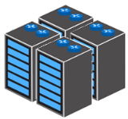



Virtual Network – “MyNetwork”
File Servers
Subnet2
192.168.2.0/24
Any combination
Web Servers
Subnet1
192.168.1.0/24
Public VIP → 10.127.132.6:80
File Server 1
Subnet Routing
VM
File Server 2
Web Server 1
VM
VM
Web Server 2
VM
GRE
Multitenant Gateway
Site-to-Site

Slide 94
Network micro segmentation and security

Slide 95
Virtual Network – “MyNetwork”
File Servers
Subnet2
192.168.2.0/24
Web Servers
Subnet1
192.168.1.0/24
Public VIP → 10.127.132.6:80
File Server 1
Subnet Routing
VM
File Server 2
Web Server 1
VM
VM
Web Server 2
VM
Multitenant Gateway

Slide 96
Virtual Network – “MyNetwork”
File Servers
Subnet2
192.168.2.0/24
Allow
Web Servers
Subnet1
192.168.1.0/24
Public VIP → 10.127.132.6:80
File Server 1
Subnet Routing
VM
File Server 2
Allow
Web Server 1
VM
VM
Web Server 2
Allow
VM
Multitenant Gateway

Slide 97
Virtual Network – “MyNetwork”
File Servers
Subnet2
192.168.2.0/24
Web Servers
Subnet1
192.168.1.0/24
Public VIP → 10.127.132.6:80
File Server 1
Subnet Routing
VM
File Server 2
Deny
Web Server 1
Deny
VM
VM
Web Server 2
Deny
Deny
Deny
Deny
VM
Multitenant Gateway

Slide 98
Virtual Network – “MyNetwork”
File Servers
Subnet2
192.168.2.0/24
Web Servers
Subnet1
192.168.1.0/24
Public VIP → 10.127.132.6:80
File Server 1
Subnet Routing
VM
File Server 2
Web Server 1
VM
VM
Web Server 2
VM
Multitenant Gateway

Slide 99
Virtual Network – “MyNetwork”
File Servers
Subnet2
192.168.2.0/24
Per VM or
Subnets
NSG
Web Servers
Subnet1
192.168.1.0/24
Public VIP → 10.127.132.6:80
File Server 1
Subnet Routing
VM
File Server 2
Web Server 1
VM
VM
Web Server 2
VM
Multitenant Gateway

Slide 100
Virtual Network – “MyNetwork”
File Servers
Subnet2
192.168.2.0/24
Per VM or
Subnets
NSG
Web Servers
Subnet1
192.168.1.0/24
Public VIP → 10.127.132.6:80
File Server 1
Subnet Routing
VM
File Server 2
Web Server 1
VM
VM
Web Server 2
VM
Multitenant Gateway

Slide 101
Virtual Network – “MyNetwork”
File Servers
Subnet2
192.168.2.0/24
Per VM or
Subnets
NSG
Web Servers
Subnet1
192.168.1.0/24
Public VIP → 10.127.132.6:80
File Server 1
Subnet Routing
VM
File Server 2
Web Server 1
VM
VM
Web Server 2
VM
Web Server 3
VM
Multitenant Gateway

Slide 102
Virtual Network – “MyNetwork”
File Servers
Subnet2
192.168.2.0/24
Web Servers
Subnet1
192.168.1.0/24
Subnet Routing
Public VIP → 10.127.132.6:80
File Server 1
VM
File Server 2
Web Server 1
VM
VM
Web Server 2
VM
Multitenant Gateway

Slide 103
File Servers
Subnet2
192.168.2.0/24
Virtual Network – “MyNetwork”
File Server 1
Web Servers
Subnet1
192.168.1.0/24
Virtual Appliance
Subnet Routing
Public VIP → 10.127.132.6:80
VM
File Server 2
Web Server 1
VM
Web Server 2
VM
VM
VM
Multitenant Gateway

Slide 104
File Servers
Subnet2
192.168.2.0/24
Virtual Network – “MyNetwork”
Network Virtual Appliances
via User Defined Routing
File Server 1
Web Servers
Subnet1
192.168.1.0/24
Virtual Appliance
User Defined Routing
Public VIP → 10.127.132.6:80
VM
File Server 2
Web Server 1
VM
Web Server 2
VM
VM
VM
Multitenant Gateway

Slide 105
File Servers
Subnet2
192.168.2.0/24
Virtual Network – “MyNetwork”
File Server 1
Web Servers
Subnet1
192.168.1.0/24
Virtual Appliance
User Defined Routing
Public VIP → 10.127.132.6:80
VM
File Server 2
Web Server 1
VM
Web Server 2
VM
VM
VM

Slide 106
Virtual Network – “MyNetwork”
File Servers
Subnet2
192.168.2.0/24
Web Servers
Subnet1
192.168.1.0/24
Public VIP → 10.127.132.6:80
File Server 1
Subnet Routing
VM
File Server 2
Web Server 1
VM
VM
Web Server 2
VM
Multitenant Gateway

Slide 107
Virtual Network – “MyNetwork”
Mirroring to
Network Virtual Appliances
Web Servers
Subnet1
192.168.1.0/24
Public VIP → 10.127.132.6:80
File Server 1
Subnet Routing
VM
File Server 2
Web Server 1
VM
Virtual Appliance
VM
Web Server 2
VM
VM
Multitenant Gateway

Slide 108
SDN Building blocks

Slide 109
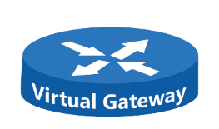
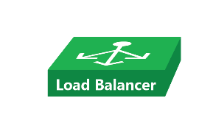
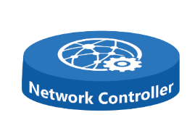
SDN Building Blocks introduction
Network Controller VMs
Virtual Machines running the Network Controller Microservices on top of Azure Service Fabric Cluster
Mux VMs
Virtual Machines running the Virtual Networks load balancer rules
Gateways VMs
Virtual Machines running the Virtual Networks Gateways
GW1
GW2
MUX1
GW3
MUX2
NC1
MUX3
NC2
NC3

Slide 110
Network Controller is the control plane of your Virtualized Network
External Network
Internal Network
Management tool (Azure Stack Hub)
Physical Top of Rack Switch
Network controller
Physical Top of Rack Switch
Hyper-V Host
Hyper-V Host
Hyper-V Host
Hyper-V Host
Hyper-V vSwitch
Hyper-V vSwitch
Hyper-V vSwitch
Hyper-V vSwitch
VM
VM
VM
VM
VM
VM
VM
VM

Slide 111
Network Controller Architecture
Highly available and scalable server role
Southbound API for the network controller (NC) to communicate with the network.
Northbound API allows you to communicate with the NC.
Relies on Windows Service Fabric for high availability
Separates functionality into service modules (microservices)
Southbound API
Network controller can discover network devices, detect service configurations, and gather all of the information you need about the network.
Provides pathway to send information to the network infrastructure, such as configuration changes that you have made.
Microsoft Azure Stack Hub
Management applications
Network-aware applications
Network controller
Virtual network infrastructure
Physical network infrastructure
NIC

Slide 112
Network Controller Architecture
Northbound API (REST interface)
Provides you with the ability to gather network information from network controller and use it to monitor and configure the network.
Configure, monitor, troubleshoot, and deploy new devices on the network by using Windows PowerShell, REST, and the Azure Stack Hub Portal
Uses a JSON data model to represent network resources
Supports CRUD operations on resources through NB API
Can manage:
Hyper-V VMs and vSwitches, VPN gateways and load balancers
Microsoft Azure Stack Hub
Management applications
Network-aware applications
Network controller
Virtual network infrastructure
Physical network infrastructure
NIC

Slide 113
SLB Multiplexer VMs (MUX)
The SLB MUX consists of one or more virtual machines
Network Controller provides each MUX VM with each VIP, and each MUX VM in turn uses Border Gateway Protocol (BGP) to advertise each VIP to routers (TOR) on the physical network as a /32 route
The MUX VMs uses the VIP to select a DIP, encapsulates the packet, and forwards the traffic to the Hyper-V host where the DIP is located.
The MUX VMs knows how to map VIPs to the correct DIPs because of load balancing policies that you define by using Network Controller
With internal traffic load balancing, the first request is sent to and processed by the MUX, which selects the appropriate DIP and routes the traffic to the DIP. From that point forward, the established traffic flow bypasses the MUX and goes directly from VM to VM

Slide 114
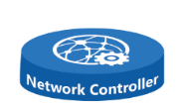
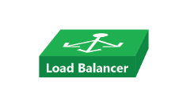
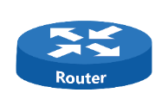
SLB/MUX Infrastructure Overview
Internet Client http request to Public VIP
TOR (router) selects 1 of the 3 BGP advertised routes from Mux VMs using ECMP
The Mux VM running the load balancer sends the packet to the selected DIP (VM IP) running the Web App
VM sends the packet back to Internet using DSR directly to the TOR (router)
Config
Microsoft Azure Stack Hub
Deploy
Health Monitor
SLB Manager
Deploy
Hyper-V Host
ECMP
DIP
Public
Internet
SLB Host Agent
DIP
BGP
DIP
Direct Server Return (DSR)

Slide 115
Windows Server Software Load Balancer Functionalities
Windows Server 2016 SDN can use Software Load Balancing (SLB) to evenly distribute tenant and tenant customer network traffic among virtual network resources.
SLB enables multiple servers to host the same workload, providing high availability and scalability.
Windows Server SLB includes the following capabilities:
SLB provides layer 4 load balancing services for North-South and East-West TCP/UDP traffic.
You can use SLB on a Hyper-V Network Virtualization-based network.
You can use SLB with a VLAN-based network for DIP VMs connected to an SDN-enabled Hyper-V virtual switch.
One SLB instance can handle multiple tenants.
SLB and DIP support a scalable and low-latency return path, as implemented by Direct Server Return (DSR).
SLB functions when you are also using Switch Embedded Teaming (SET) or Single Root Input/Output Virtualization (SR-IOV).
SLB includes Internet Protocol version 4 (IPv4) support.
For site-to-site gateway scenarios, SLB provides NAT functionality to enable all site-to-site connections to use a single public IP.

Slide 116





Windows Server 2016 Highly Available Network Gateway Basics
It supports Multitenant mode (edge gateway)
RAS Gateway is fully integrated with Network Controller in Windows Server 2016
Switches network traffic flows to a standby gateway in the event of a gateway failure (HA)
Windows Server 2016 supports IKEv2, GRE and L3 Forwarding Site to Site tunnels connectivity (Hybrid Networking)
Routes are exchanged between on-premises and cloud gateways If BGP is enabled

Slide 117
Multi-Tenant S2S VPN IKEv2 Gateway Architecture
Microsoft Azure Stack Hub
Northbound Interface
Network Controller
Deployment and Setup
HA and Load Balancing
Policy Configuration
HNV and Route Configuration
GW Failure – IKEv2 S2S Connection
NC detects failure of a GW node
NC picks one of the ‘N’ standby GWs, replicates the configuration (including BGP RR), and updates NAT mapping
Fresh S2S connection terminates on new GW; no changes required on-premises
NC updates HNV policies in the VNET
Provisioning S2S Connection
Tenant uses self-service portal to request a connection
NC picks a pool and a gateway with available capacity, creates connection policy, and configures BGP router
NC creates a rule on the NAT to map incoming connection to designated GW
GRE and L3 directly terminate on GW, so no NAT required
Routes exchanged over the connection are sent to NC, which pushes down HNV policies to VNET
Southbound Interface
Updated HNV Polices
HNV Policies
Route Exchange
Contoso Washington Site
S2S VPN
GW1
Contoso
Virtual Network
S2S VPN
IP1
GW2
BGP Router
SLB
Woodgrove
Virtual Network
IP1 GW1
GW3
Gateway
Pool
Hoster

Slide 118
Windows Server 2016 RAS Gateway Functionalities
In Windows Server 2016, RAS Gateway routes network traffic between the physical network and VM network resources, regardless of where the resources are located. You can use RAS Gateway to route network traffic between physical and virtual networks at the same physical location or at many different physical locations.
RAS Gateway includes the following capabilities:
Site-to-site VPN. This RAS Gateway feature allows you to connect two networks at different physical locations across the Internet by using a site-to-site VPN connection.
Point-to-site VPN. This RAS Gateway feature allows organization employees or administrators to connect to your organization's network from remote locations. (available in Azure Stack Hub post-GA)
Dynamic routing with Border Gateway Protocol (BGP). BGP reduces the need for manual route configuration on routers because it is a dynamic routing protocol, and automatically learns routes between sites that are connected by using site-to-site VPN connections
Network Address Translation (NAT). Network address translation (NAT) allows you to share a connection to the public Internet through a single interface with a single public IP address.

Slide 119
Hyper-V Network Virtualization v2

Slide 120





HNVv2 Provider and Customer Address Spaces packet flow
Packet from RedVM1 to RedVM2 (Red Tenant Virtual Network ID 5001)
Provider Address Space
172.16.0.11 ->
172.16.0.14
UDP: Src Port -> 4789
VNI
5001
MAC
Customer Address Space
192.168.33.4 -> 192.168.33.5
Payload
Packet from BlueVM1 to BlueVM2 (Blue Tenant Virtual Network ID 5002)
Provider Address Space
172.16.0.12 ->
172.16.0.16
UDP: Src Port -> 4789
VNI
5002
MAC
Customer Address Space
192.168.33.4 -> 192.168.33.5
Payload
Mgmt: 192.168.1.10/24
RDMA1: 10.0.1.10/24
RDMA2: 10.0.1.11/24
PAHostvNIC1: 172.16.0.10/24
PAHostvNIC2: 172.16.0.11/24
DRHostvNIC: PIPA address
Mgmt: 192.168.1.11/24
RDMA1: 10.0.1.12/24
RDMA2: 10.0.1.13/24
PAHostvNIC1: 172.16.0.12/24
PAHostvNIC2: 172.16.0.13/24
DRHostvNIC: PIPA address
Mgmt: 192.168.1.12/24
RDMA1: 10.0.1.14/24
RDMA2: 10.0.1.15/24
PAHostvNIC1: 172.16.0.14/24
PAHostvNIC2: 172.16.0.15/24
DRHostvNIC: PIPA address
Mgmt: 192.168.1.13/24
RDMA1: 10.0.1.16/24
RDMA2: 10.0.1.17/24
PAHostvNIC1: 172.16.0.16/24
PAHostvNIC2: 172.16.0.17/24
DRHostvNIC: PIPA address

Slide 121

HNVv2 Host vNICs and Compartments
Default Compartment (Active)
Management and RDMA Host vNICs are used to connect the Hyper-V host with the Domain (Mgmt) and to enable high speed / low latency connectivity between the Hyper-V host when using Remote Direct Memory Access (RDMA) for storage replication, High Speed Live Migrations or Storage Spaces Direct
These Host vNICs run on the Default (Active) compartment and will not be managed by Network Controller
Mgmt Host vNIC
RDMA Host vNIC1
pNIC1
pNIC2
RDMA Host vNIC2
SET vSwitch
Mgmt Host vNIC
VFP Extensions
RDMA Host vNIC1
Provider Address Compartment
The Provider Address (PA) Host vNICs are used to hold the IP and MAC address used to construct the outer packet's header for transporting encapsulated traffic. They are also used for things like sending ARPs to discover the MAC address of the remote Hyper-V Host (VTEP)*. We always assign two IP addresses (and create two PA Host vNICs) from the HNV Provider Logical Network (Transport network) IP Pool to each Hyper-V host to maximize inbound spreading for Switch-Embedded Teaming (SET) deployments using two NIC team members
RDMA Host vNIC2
PA Host vNIC1
PA Host vNIC1
PA Host vNIC2
DR Host vNIC
PA Host vNIC2
Distributed Router Compartment
Distributed Router (DR) Host vNIC is created in a separate network compartment on the Hyper-V Host and used by the HNV Distributed Router to directly route traffic between virtual subnets.
DR Host vNIC
* VTEP = VXLAN Tunnel Endpoint

